Slide 1
UTTAR PRADESH LOK SABHA ELECTIONS 2014
Analysis of Results and
Future Strategy for Muslims
By Abdul Jabbar
Email: abdu_jabbar@rediffmail.com
Mobile: +91 9866882822

Slide 2

O ye who believe! Persevere in patience and constancy; vie in such perseverance; strengthen each other; and fear Allah; that ye may prosper.
(Aal e Imran: 200)

Slide 3
BJP’s Landslide Victory in Uttar Pradesh: Reasons
Divide & Conquer: Vote split among BJP’s opponents
Muzaffar Nagar riots polarized the hindu votes
Lack of planning from Muslim leadership (Political / religious) in channelizing the muslim vote base.
BJP was fully prepared, whereas opposition underestimated and was confident of its victory

Slide 4
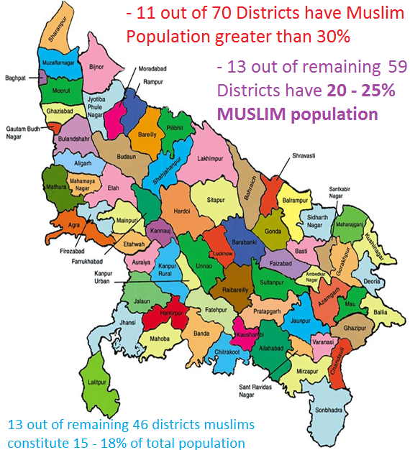
Uttar Pradesh: District-wise Muslim Population %(2001)
Rampur | 49.14
Moradabad | 45.54
Bijnor | 41.71
Jyotiba Phule Nagar * | 39.38
Saharanpur | 39.11
Muzaffarnagar | 38.09
Balrampur * | 36.72
Bahraich | 34.83
Bareilly | 33.89
Meerut | 32.55
Siddharthnagar | 29.43
Shrawasti * | 25.60
Baghpat * | 24.73
Sant Kabir Nagar * | 24.02
Ghaziabad | 23.79
Pilibhit | 23.75
Barabanki | 22.04
Budaun | 21.33
Bulandshahar | 21.07
Lucknow | 20.52
Gonda | 19.26
Sitapur | 19.23
Kheri | 19.10
Mau | 19.04
Shahjahanpur | 17.86
Aligarh | 17.78
Kushinagar * | 16.86
Mahrajganj | 16.46
Ambedkar Nagar * | 16.39
Sultanpur | 16.32
Varanasi | 15.85
Kannauj * | 15.78
Kanpur Nagar | 15.69
Azamgarh | 15.07
Farrukhabad | 14.81
Basti | 14.70
Faizabad | 14.57
Pratapgarh | 13.70
Kaushambi * | 13.51
Fatehpur | 13.30
Hardoi | 13.11
Gautam Buddha Nagar * | 13.01
Allahabad | 12.72
Firozabad | 12.68
Bhadohi | 11.96
Rae Bareli | 11.84
Etah | 11.45
Deoria | 11.38
Unnao | 10.99
Chandauli * | 10.24
Jaunpur | 10.20
Hathras * | 10.09
Jalaun | 10.06
Ghazipur | 9.89
Kanpur Dehat | 9.31
Gorakhpur | 9.15
Agra | 8.94
Banda | 8.21
Mathura | 8.08
Hamirpur | 7.96
Mirzapur | 7.48
Jhansi | 7.44
Etawah | 7.16
Auraiya * | 7.09
Mahoba * | 6.68
Ballia | 6.57
Sonbhadra | 5.40
Mainpuri | 5.30
Chitrakoot * | 3.55
Lalitpur | 2.95

Slide 5
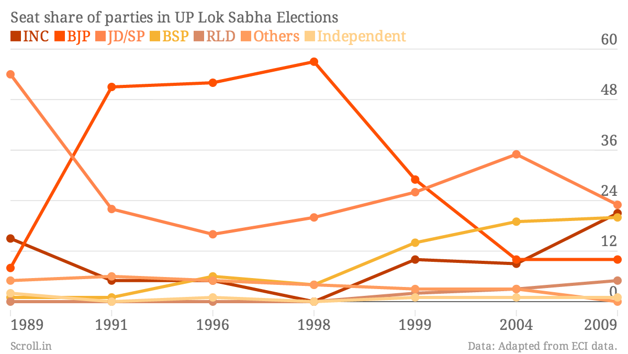
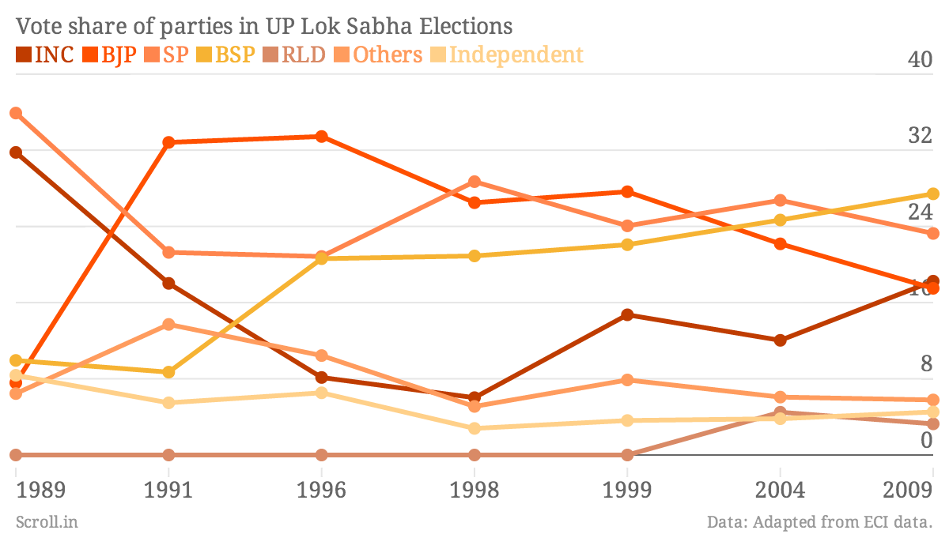
UP: Lok Sabha Result trends of past 8 elections
Election Year | BJP | SP | BSP | INC | JD | IND | Others | JP
1989 | 8 |  | 2 | 15 | 54 | 2
1991 | 51 |  | 1 | 5 | 22 |  | 1 (CPI) | 4
1996 | 52 | 16 | 6 | 5
1998 | 57 | 20 | 4 | 0
1999 | 29 | 26 | 14 | 10 | 2 (ABLTC) | 1 | 2 (RLD) | 1 (SJP (R))
2004 | 10 | 35 | 19 | 9 | 1 (JD (U)) | 1+1 | 3 (RLD) | 1 (SJP (R))
2009 | 10 | 23 | 20 | 21 |  | 1 | 5 (RLD)
2014 | 70 | 6 | 0 | 2 |  | 2 (AD)

Slide 6
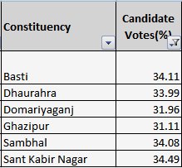
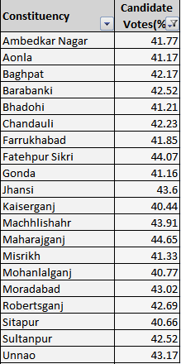
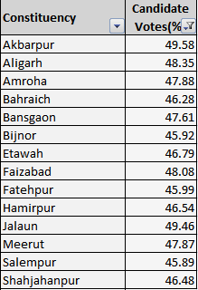
BJP’s Landslide victory in UP: Quick facts
BJP’s Vote Share in 70 seats it won:
6 / 70 seats between 31 – 35 %
14 / 70 seats between 35 – 39 %
20 seats between 40 – 44%
14 seats between 45 – 49 %

Slide 7
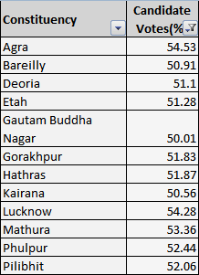
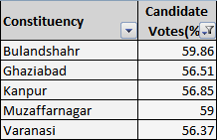
BJP’s Landslide victory in UP: Quick facts
Only in 16 seats BJP’s vote share is greater than 50%
20 / 70 constituencies BJP’s vote share is between 40 – 44%
14 / 70 constituencies BJP’s vote share is between 45 – 49 %
Inference:
BJP as a party can sure shot win ONLY 16 seats on its own, rest other seats can be won by it is only due to splitting of votes among its opponents.

Slide 8
Strategy to be adopted by Muslims

Slide 9
Political Strategy
Coordination body of Muslim Politicians / Social activists / NGOs / Ulema to be formed to:
Plan
Execute
Monitor the strategy execution
Below is the activity chart and responsibilities
Task | Responsibility
Strive to form Greater Secular Alliance among AIMIM, SP, BSP, INC and RLD | Coordination Body of Muslims
High level lobbying to keep secular parties together | Coordination Body of Muslims
Dalit + Muslim vote consolidation against BJP. | Coordination Body + Muslim Politicians across party line
Communal amity to be developed between muslims and hindus | Coordination Body of Muslims
Campaigns for ensuring close to 100% enrollment of Muslim + Dalit voters in voter list at booth level | Coordination Body + Muslim NGOs + Students of Madaris
Booth level monitoring / tracking of voters / votes casted on the election day | Muslim NGOs + Political Parties
Counseling of INDEPENDENT Muslim candidates NOT to contest elections. | Coordination Body of Muslims
Build an All India Secular Forum having Muslims, Secular Hindus, Christians, Dalits and other OBCs against fascist forces | Coordination Body of Muslims
* Other tasks can be thought of which can be non – political / political in nature to support the over all political cause

Slide 10
Seats Classification
Categorization of seats won by BJP in general election 2014, where its vote share was less than 50%
 | Category | Details
1 | BRIGHT Chances of Secular win | Greater Secular Alliance to be formed 17 seats where votes polled by alliance of 2 secular parties together greater than BJP by Minimum 80,000 votes
2 | FAIR Chances of Secular win | Greater Secular Alliance to be formed 8 seats where votes polled by alliance of 2 secular parties together BJP by 50,000 – 70,000 votes
3 | TOUGH FIGHT for Secular win | Greater Secular Alliance of 3 secular parties (BSP +SP + INC / RLD) 17 seats where votes polled by Alliance of 2 Secular parties > BJP by minimum of 20,000 votes Alliance of 3 Secular parties > BJP by minimum of 39,000 votes
4 | VERY TOUGH FIGHT for Secular win | Greater Secular Alliance of 3 secular parties (BSP +SP + INC / RLD) 7 seats where votes polled by Alliance of 2 Secular parties > BJP by minimum of 7,000 votes Alliance of 3 Secular parties > BJP by minimum of 25,000 votes

Slide 11
BRIGHT CHANCES of Victory for Secular alliance
As per results of 2014 LS election, Secular Alliance of 2 partners > BJP by 80,000
 | Constituency | SP | BSP | INC | BJP | Equation | Margin | Muslim Vote % | Muslim Support | Comment
1 | Bhadohi | 238615 | 245505 |  | 403544 | BJP < (SP + BSP) | 81,000 | 12.7% | TOUGH | Districts: Allahabad + Sant Rvdsngr
2 | Basti | 324118 | 283747 |  | 357680 | BJP < (SP + BSP) | 2,00,000 | 14.7 % | TOUGH | Districts: Basti
3 | Dhaurahra | 234032 | 234682 | 170994 | 360357 | BJP < (SP + BSP) | 1,50,000 | 19.1% |  | Muslim BSP Candidate RUNNER UP Districts: Kheri + Sitapur
4 | Domariyagunj | 174778 | 195257 | 88117 | 298845 | BJP < (SP + BSP) Muslim IND (PECP) | 90,000 | 29.4% | TOUGH | Muslim BSP Candidate RUNNER UP Muslim IND (PECP) cut 90K votes Districts: Siddharth Nagar
5 | Ghazipur | 274477 | 241645 |  | 306929 | BJP < (SP + BSP) | 2,00,000 | 9% |  | Districts: Ghazipur
6 | Hardoi (SC) | 276478 | 279105 |  | 360434 | BJP < (SP + BSP) | 1,90,000 | 13% | TOUGH | Districts: Hardoi
7 | Rampur | 335181 | 81006 | 156466 | 358616 | BJP < (SP + INC) | 1,32,000 | 49% |  | Districts: Rampur
8 | Saharanpur | 52765 | 235033 | 407909 | 472999 | BJP < (SP + BSP) | 1,70,000 | 39% |  | Districts: Saharanpur
9 | Sambhal | 355068 | 252640 |  | 360242 | BJP < (SP + BSP) | 2,40,000 | 45.5% |  | Districts: Moradabad
10 | Sant Kabirnagar | 240169 | 250914 |  | 348892 | BJP < (SP + BSP) | 1,50,000 | 16 (Avg) |  | Districts: SKBNR + AMBNGR + GOR
11 | Misrikh (SC) | 194759 | 325212 |  | 412575 | BJP < (SP + BSP) | 1,07,000 | 16 (Avg) |  | District: Sitapur + Hardoi + Kpurngr
12 | Mohanlal gunj | 242366 | 309858 |  | 455274 | BJP < (SP + BSP) | 1,00,000 | 19 (Avg) |  | District: Sitapur + Lucknow
13 | Kaushambhi | 288774 | 201223 | 31944 | 331640 | BJP < (SP + BSP) | 1,58,357 | 13.5% |  | District: Kaushambi (4) + Pratapgarh (2)
14 | Lalganj | 260930 | 233971 |  | 324016 | BJP < (SP + BSP) | 1,70,885 | 15% |  | District: Azamgarh(5)
15 | Misrikh (SC) | 194759 | 325212 |  | 412575 | BJP < (SP + BSP) | 1,07,396 | 16 (Avg) |  | Sitapur (3), Hardoi (1), Kanpur ngr(1)
16 | Mohanlal gunj (SC) | 242366 | 309858 |  | 455274 | BJP < (SP + BSP) | 96,950 | 20 (Avg) |  | Sitapur (1), Lucknow(4)
17 | Sitapur | 156170 | 366519 |  | 417546 | BJP < (SP + BSP) | 1,05,143 | 19% |  | Sitapur (5)

Slide 12
Party – wise Vote Share in last 25 Years
BHADOHI |  |  |  |  |  |  |  |  |  |  |  |  | BASTI
Party / Year | 2014 |  | 09 | 04 | 99 | 98 | 96 | 91 | 89 | Avg | Min | Max | Party / Year | 2014 | 09 | 04 | 99 | 98 | 96 | 91 | 89 | Avg | Min | Max
SP | 25 |  | 28 |  |  |  |  |  |  | 26 | 25 | 28 | SP / JD | 31 | 21 | 23 | 25 | 28 | 28 | 21 | 21 | 25 | 21 | 31
BSP | 24 |  | 30 |  |  |  |  |  |  | 27 | 24 | 30 | BSP | 27 | 35 | 27 | 29 | 23 | 25 |  |  | 28 | 23 | 35
JDU / INC | 3 |  | 14 |  |  |  |  |  |  | 8 | 3 | 14 | INC | 3 | 14
Muslim Vote Share |  |  | 9% |  |  |  | Muslim's Support |  |  |  |  |  | Muslim Vote Share |  | 15% |  |  |  | Muslim's Support
Comments | Tough competition between BSP and SP. But BSP has edge. |  |  |  |  |  |  |  |  |  |  |  | Comments | BSP has been making a come-back here. Minimum vote share has been 23 and average vote share of 28%. BJP has won this seat 4 out of 8 times.
DHAURAHRA |  |  |  |  |  |  |  |  |  |  |  |  | DOMARIYA GUNJ
Party / Year | 2014 | 09 |  | 04 | 99 | 98 | 96 | 91 | 89 | Avg | Min | Max | Party / Year | 2014 | 09 | 04 | 99 | 98 | 96 | 91 | 89 | Avg | Min | Max
SP | 22 | 14 |  |  |  |  |  |  |  | 18 |  |  | SP | 19 | 8 | 21 | 25 | 26 | 34 |  |  | 22 | 8 | 34
BSP | 22 | 27 |  |  |  |  |  |  |  | 25 | 22 | 27 | BSP | 21 | 21 | 32 | 16 | 29 |  |  |  | 24 | 16 | 32
INC | 16 | 52 |  |  |  |  |  |  |  | 34 | 16 | 52 | INC |  | 31 | 23 | 26 |  |  | 28 | 28
Muslim Vote Share |  | 20% |  |  |  |  | Muslim's Support |  |  |  |  |  | Muslim Vote Share |  | 30% |  |  |  | Muslim's Support
Comments | Tough competition between BSP and SP. BSP has edge. |  |  |  |  |  |  |  |  |  |  |  | Comments | Muslims self damaging. 2014 & 2009 : Muslim BSP Candidate RUNNER UP. Muslim Independent candidate cut 90,000 votes
GHAZIPUR |  |  |  |  |  |  |  |  |  |  |  |  | HARDOI
Party / Year | 2014 | 09 |  | 04 | 99 | 98 | 96 | 91 | 89 | Avg | Min | Max | Party / Year | 2014 | 09 | 04 | 99 | 98 | 96 | 91 | 89 | Avg | Min | Max
SP | 28 | 49 |  | 48 | 31 | 36 |  |  |  | 38 | 28 | 49 | SP / JP | 28 | 51 | 39 | 36 | 37 | 26 | 18 |  | 34 | 26 | 51
BSP | 24 | 40 |  | 21 | 23 | 23 | 27 |  |  | 27 | 21 | 40 | BSP | 29 | 35 | 32 |  | 26 | 30
CPI |  |  |  |  |  |  | 21 | 38 | 38 |  |  |  | ABLTC / INC |  |  |  | 37 |  |  | 22
Muslim Vote% |  | 9% |  |  |  |  | Muslim's Support |  |  |  |  |  | Muslim Vote% |  | 13% |  |  |  | Muslim's Support
Comments | Traditional strong hold of SP with a min vote share of 28% & average vote share of 38%
 |  |  |  |  |  |  |  |  |  |  |  |  | Comments | Traditional strong hold of SP with a min vote share of 28% & average vote share of 38%
RAMPUR |  |  |  |  |  |  |  |  |  |  |  |  | SAHARANPUR
Party / Year | 2014 | 09 |  | 04 | 99 | 98 | 96 | 91 | 89 | Avg | Min | Max | Party / Year | 2014 | 09 | 04 | 99 | 98 | 96 | 91 | 89 | Avg | Min | Max
SP | 35 | 38 |  | 35 | 11 | 14 | 20 |  |  | 26 | 11 | 38 | SP | 4 | 33 | 35 | 5 | 17 | 33 | 18 |  | 34 | 26 | 51
BSP | 8 | 15 |  | 15 | 13 | 16 | 11 | 3 | 3 | 27 | 21 | 40 | BSP | 19 | 43 | 33 | 31 | 26 | 22
CPI |  |  |  |  |  |  | 21 | 38 | 38 |  |  |  | INC | 34 | 8
Muslim Vote% |  | 49% |  |  |  |  | Muslim's Support |  |  |  |  |  | Muslim Vote% |  | 13% |  |  |  | Muslim's Support
Comments | Traditional strong hold of SP with a min & average vote of 35% & 36% in last 3 elections |  |  |  |  |  |  |  |  |  |  |  | Comments | SAHARANPUR seems a traditional strong hold of SP with a min vote share of 28% & average vote share of 38%

Slide 13
Party – wise Vote Share in last 25 Years
Sambhal |  |  |  |  |  |  |  |  |  |  |  | Sant Kabirnagar
Party / Year | 2014 | 09 | 04 | 99 | 98 | 96 | 91 | 89 | Avg | Min | Max | Party / Year | 2014 | 09 | 04 | 99 | 98 | 96 | 91 | 89 | Avg | Min | Max
SP | 34 | 28 | 47 | 42 | 50 |  | 26 | 26 | 36 | 26 | 50 | SP | 24 | 21 |  |  |  |  |  |  | 22 | 21 | 24
BSP | 24 | 30 | 21 | 22 | 18 | 35 |  |  | 25 | 18 | 35 | BSP | 25 | 26 |  |  |  |  |  |  | 25 | 25 | 26
JDU/INC/RLD |  | 19 |  |  |  |  |  |  |  |  |  | JDU/INC/RLD
Muslim Vote Share |  | 46% |  |  |  | Muslims to support |  |  |  |  |  | Muslim Vote Share |  | 16% |  |  |  | Muslims to support
Comments | 2014 : II & III place to BSP & SP MUSLIM Candidates making a clear way for BJP to win. |  |  |  |  |  |  |  |  |  |  | Comments | BSP having a consistent vote share of 25% with a minimum of 23% and average of 28% vote share.
Misrikh (SC) |  |  |  |  |  |  |  |  |  |  |  | Mohanlal Ganj
Party / Year | 2014 | 09 | 04 | 99 | 98 | 96 | 91 | 89 | Avg | Min | Max | Party / Year | 2014 | 09 | 04 | 99 | 98 | 96 | 91 | 89 | Avg | Min | Max
SP | 20 | 30 | 34 | 26 | 29.6 | 26 | 18 | 18 |  |  |  | SP /JP | 22 | 37 | 25.9 | 30 | 34 | 28 | 25 |  | 29
BSP | 33 | 34 | 38 | 25 | 29.8 | 23 |  |  |  |  |  | BSP | 28 | 26 | 25.6 | 22
INC |  |  |  |  |  |  | 31 | 31 |  |  |  | INC / RSBP |  | 21 |  |  |  | 22 | 22
Muslim Vote Share |  | 16% |  |  |  | Muslims to support |  |  |  |  |  | Muslim Vote Share |  | 20% |  |  |  | Muslims to support
Comments | SP won 1 time and BSP won 3 times. SC reserved seat. BJP won only in '96 and '14. Vote split by SP / BSP |  |  |  |  |  |  |  |  |  |  | Comments | Traditional strong hold of SP, winning 4 out of 8 elections, Avg vote share - 29%, Min Vote Share-22% .
Kaushambhi |  |  |  |  |  |  |  |  |  |  |  | LALGANJ
Party / Year | 2014 | 09 | 04 | 99 | 98 | 96 | 91 | 89 | Avg | Min | Max | Party / Year | 2014 | 09 | 04 | 99 | 98 | 96 | 91 | 89 | Avg | Min | Max
SP | 32 | 45 |  |  |  |  |  |  | 39 |  |  | SP / JD | 29 | 22 | 37 | 29 | 35 | 28 | 28 |  | 30
BSP | 22 | 36 |  |  |  |  |  |  |  |  |  | BSP | 26 | 32 | 32 | 33 | 33 | 37 | 20 |  | 30
CPI |  |  |  |  |  |  |  |  |  |  |  | ABLTC / INC
Muslim Vote% |  | 14% |  |  |  | Muslim's Support |  |  |  |  |  | Muslim Vote% |  | 15% |  |  |  | Muslim's Support
Comments | Traditional strong hold of SP, winning 1 out of 2 elections, Avg vote share - 39%, Min Vote Share-32% . |  |  |  |  |  |  |  |  |  |  | Comments | Never has BJP won here. TUG of war between SP and BSP. Since SP has been runner up with 29% vote share.
SITAPUR |  |  |  |  |  |  |  |  |  |  |  | SITAPUR
Party / Year | 2014 | 09 | 04 | 99 | 98 | 96 | 91 | 89 | Avg | Min | Max | Comments | Strong hold of BSP with a min & average vote of 24% & 31% in last 5 elections. MUSLIM candidate fielded by BSP and SP.
SP | 15 | 31 | 28 | 20 | 26 | 30
BSP | 36 | 34 | 29 | 33 | 29 | 24
CPI
Muslim Vote% |  | 20% |  |  |  | Muslim's Support |  |  |  |  | BSP

Slide 14
Fair Chances for a Secular Alliance
Secular Alliance of 2 partners > BJP by 50K – 70K
Greater Secular Alliance (GSA)
 | Constituency | SP | BSP | INC | OTH | BJP | Equation | Margin | %ge | Support | Inference
1 | Aonla | 271478 | 190200 |  |  | 409907 | BJP < (BSP + SP) | 50,000 | 27 |  | Districts: Badayun + Bareli
2 | Banda | 189730 | 226278 | 36650 |  | 342066 | BJP < (SP + BSP) BJP << (BSP + SP + INC) | 50,000 | 5 | TOUGH DECISION | Districts: Banda + Chitrakoot
3 | Bijnor | 281139 | 230124 |  |  | 486913 | BJP < (SP + BSP) BJP << (SP + BSP + RLD) | 26,000 50,000 | 37 |  | Districts: MZFRNGR + BIJ + Meerut
4 | Chandouli | 204145 | 257379 |  |  | 414135 | BJP < (SP + BSP) | 50,000 | 13%
5 | Jaunpur | 180003 | 220839 |  | 43,000 | 367149 | BJP < (SP + BSP) |  | 10% | TOUGH DECISION | AAP cut 43000 secular votes
6 | Moradabad | 397720 | 160945 |  |  | 485224 | BJP < (SP + BSP) | 73,000 | 44% |  | SP to be supported GSA
7 | Kaisergunj | 303282 | 146726 | 57401 |  | 381500 | BJP < (SP + BSP) | 68,508 | 25% |  | Bahraich (2)+ Gonda (4) GSA
8 | Kheri | 160064 | 288331 | 183993 |  | 398597 | BJP < (BSP + INC) BJP < (BSP + INC + SP ) | 48,000 2,33,778 | 19% |  | District: Kheri
Percentage represents muslim population in respective constituency / district

Slide 15
Party – wise Vote Share in last 25 Years
AONLA |  |  |  |  |  |  |  |  |  |  |  | BANDA
Party / Year | 2014 | 09 | 04 | 99 | 98 | 96 | 91 | 89 | Avg | Min | Max | Party / Year | 2014 | 09 | 04 | 99 | 98 | 96 | 91 | 89 | Avg | Min | Max
SP | 28 | 30 | 27.3 | 34 | 38 | 31 |  |  | 31 | 27 | 38 | SP / JD | 22 | 39 | 35 | 31 | 25 |  |  |  | 30 | 22 | 39
BSP | 19 | 25 | 26.5 | 24 | 20 | 29 |  |  | 24 | 19 |  | BSP | 26 | 33 | 24 | 36 | 30 | 35 | 25 | 25 | 29 | 24 | 36
JDU / INC |  |  | 29 |  |  |  | 21 | 21 |  |  |  | CPI |  |  |  |  |  |  | 18 | 18
Muslim Vote Share |  | 27% |  |  |  | Muslims to support |  |  |  |  |  | Muslim Vote Share |  | 5% |  |  |  | Muslims to support
Comments | Good base of SP. Has won 2 times in the past. Average vote share of 31% and Min vote share 27% |  |  |  |  |  |  |  |  |  |  | Comments | SP & BSP, have been alternatively winning. Both have average vote share of 30 & 29%. Seeing the 2014 performance.
BIJNOR |  |  |  |  |  |  |  |  |  |  |  | CHANDOULI
Party / Year | 2014 | 09 | 04 | 99 | 98 | 96 | 91 | 89 | Avg | Min | Max | Party / Year | 2014 | 09 | 04 | 99 | 98 | 96 | 91 | 89 | Avg | Min | Max
SP | 27 | 7 |  | 27 | 37 | 32 |  |  | 31 |  |  | SP | 21 | 26.9 | 28.8 | 36.5 | 31 | 26.8 | 28.4 | 28.4 | 28 | 21 | 37
BSP | 21 | 31 | 31 | 26 | 24 | 26 | 31 | 31 | 27 |  |  | BSP | 26 | 26.8 | 29 | 26.0 | 26 | 21.7 | 19.5 | 19.5 | 24 | 20 | 29
CPI/INC/RLD/IND | 2 | 35 | 43 |  |  |  |  |  |  |  |  | CPI/INC/RLD/IND
Muslim Vote Share |  | 37% |  |  |  | Muslims to support |  |  |  |  |  | Muslim Vote Share |  | 14% |  |  |  | Muslims to support
Comments | SP had a strong base here, but BSP regained in the recent past, but in 2014 SP bounced back, avg vote share is 31%. |  |  |  |  |  |  |  |  |  |  | Comments | SP had a strong base here, but BSP has made a come back since last 2 elections. TOUGH DECISION
JAUNPUR |  |  |  |  |  |  |  |  |  |  |  | MORADABAD
Party / Year | 2014 | 09 | 04 | 99 | 98 | 96 | 91 | 89 | Avg | Min | Max | Party / Year | 2014 | 09 | 04 | 99 | 98 | 96 | 91 | 89 | Avg | Min | Max
SP | 18 | 29 | 31 | 29 | 33 | 27 | 36 | 36 | 30 | 18 | 36 | SP / JP | 35 |  | 33.3 | 25.0 | 40.0 | 38.0 | 41.0 | 41.0 | 36 | 25 | 40
BSP | 22 | 40 | 27 | 26 | 31 | 23 |  |  |  |  |  | BSP | 14 |  | 23.0 |  | 19.0 | 17.7 |  |  | 18 | 14 | 23
CPI/INC/RLD/IND |  |  |  |  |  |  |  |  |  |  |  | INC / ABLTC | 2 | 40 |  | 40
Muslim Vote% |  | 10% |  |  |  | Muslim's Support |  |  |  |  |  | Muslim Vote% |  | 45% |  |  |  | Muslim's Support
Comments | Traditional strong hold of SP. BSP has been making a come back since last 2 elections, and SP seems to be losing its base. |  |  |  |  |  |  |  |  |  |  | Comments | SP has a Average vote share of 33%, winning a couple of times BSP no where in the competition. INDEPENDENT party PECP, cutting votes in 2014 elections.
KAISER GUNJ |  |  |  |  |  |  |  |  |  |  |  | KHERI
Party / Year | 2014 | 09 | 04 | 99 | 98 | 96 | 91 | 89 | Avg | Min | Max | Party / Year | 2014 | 09 | 04 | 99 | 98 | 96 | 91 | 89 | Avg | Min | Max
SP | 32.2 | 34.7 | 38.6 | 36.8 | 39.6 | 39.8 | 29.6 |  | 36 | 30 | 39 | SP | 15 | 22 | 32 | 29 | 37 | 25 |  |  | 27
BSP | 15.6 | 21.9 | 20.0 | 29.0 | 18.6 | 16.2 |  |  | 20 | 15 | 29 | BSP | 27 | 26 | 30 | 26 | 24 | 21 |  |  | 26
CPI |  |  |  |  |  |  |  |  |  |  |  | INC | 17 | 25 |  |  |  |  | 25 | 25 | 23
Muslim Vote% |  | 26% |  |  |  | Muslim's Support |  |  |  |  |  | Muslim Vote% |  | 20% |  |  |  | Muslim's Support
Comments | SP has a Average vote share of 35%. Has won the last 4 consecutive elections. BSP no where in the competition. |  |  |  |  |  |  |  |  |  |  | Comments | Tough Competition between SP, BSP and Congress. SP and INC losing base… INC fielded Muslim Candidate Zafar Ali Naqvi in 2014 and '09.

Slide 16
Tough Fight for victory of Secular Alliance
Greater Secular Alliance of 3 secular parties
Alliance of 2 Secular parties > BJP by 20K Alliance of 3 Secular parties > BJP by 39K
 | Constituency | SP | BSP | INC | IND | BJP | Equation | Margin | Muslim % | Districts covered
1 | Farrukhabad | 255693 | 114521 | 95543 | 58729 (IND) | 406195 | BJP < (SP + BSP + Cong) Game Changer: IND | 59,000 (3) | 15% | Itah (1), Farrukhabad (4)
2 | Fatehpur | 179724 | 298788 | 46588 |  | 485994 | BJP < (SP + BSP + Cong) Muslim BSP Candidate | 39,000 (3) | 13%
3 | Fatehpur Sikri | 213397 22.05% | 253483 26.19% |  | 24199 2.5% | 426589 44.07% | BJP < (SP + BSP + RALOD) | 40,000 (2) 64,000 (3) | 9% | Agra
4 | Barabanki | 159284 14.91% | 167150 15.65% | 242336 22.69% |  | 454214 42.52% | BJP < (SP + BSP + INC) | 1,10,000 (3) | 22% | Barabanki (5)
5 | Machhli shehar | 191387 19.18% | 266055 26.66% | 36323 3.64% |  | 438210 43.91% | BJP < (SP + BSP) | 19,000 (2) 55,000 (3) | 13 (Avg) | JAUNPUR(4), Varanasi (1)
6 | Ghosi | 165887 16% | 233782 22.5% |  | 166443 16% | 379797 36.53% | BJP < (SP + BSP + QED) QED (OTH) Muslim cand resp for BJP’s victory | 21,000 (2) 1,80,000 (3) | 15% | Mau (4) 19.6% Ballia (1) 6%
7 | Mirzapur | 108859 10.8% | 217457 21.58% | 152666 15.15% |  | 436536 43.32% |  | 49,000 (2) 91,000 (3) | 8% | Mirzapur (5)
8 | Sultanpur | 228144 | 231446 | 41979 |  | 410348 | BJP<(BSP + SP) BJP << (BSP + SP +INC) | 49,000
9 | Baghpat | 213609 | 141743 |  | 199516 | 423475 | BJP < (BSP + SP + RLD) | 1,20,000
10 | Kushi Nagar | 132881 | 111256 | 284511 |  | 370005 | BJP < (INC + SP) BJP < (INC + SP + BSP) | 47,341 1,58,900
(3) indicates coalition of 3 secular parties (2) indicates coalition of 2 secular parties

Slide 17
Tough Fight: Party – wise Vote share trend in last 25 years
 | Constituency | 2014 | 2009 | 2004 | 1999 | 1998 | 1996 | 1991 | 1989 | Inference
1 | FARRUKHABAD Districts Farrukhabad (4) Etah (1) | BJP 42% | INC 28% | SP 26% | SP 35% | BJP 32% | BJP 40% | INC 30% | INC 30% | TOUGH fight between SP and INC SP has upper hand, with a average voteshare 25% INC’s vote share fluctuating Muslims(13%) + Dalits (16%): 29%
 |  | SP 26% | BSP 23% | INC 26% | BJP 25% | SP 27% | SP 25%
 |  |  | SP 21% | BJP 20% | INC 25% | INC 25% | INC 17%
 |  |  | BJP 19% | BSP 17% |  | BSP 15% |  |  |  | Muslims to support:
2 | FATEHPUR Districts Fatehpur (5) | BJP 46% | SP 32% | BSP 32% | BJP 27% | BJP 40% | BSP 33% | JD 53% | JD 53% | TOUGH fight between BSP & SP BSP has upper hand, with average voteshare > 24%. SP vote share fluctuating Muslims(13%) + Dalits (25%): 38%
 |  | BSP 28% | BSP 24% | SP 22% | BSP 26% | BSP 32%
 |  | SP 17% | BJP 17% | BJP 20% | SP 23% | SP 21%
 |  |  |  |  |  |  |  |  |  | Muslims to support:
3 | FATEHPUR SIKRI Districts Agra (5) | BJP 44% | BSP 30% |  |  |  |  |  |  | TOUGH fight among BSP/ INC/ SP BSP has upper hand, with average voteshare > 24%. Muslims(9%) + Dalits (21%): 30%
 |  | BSP 26% | INC 28%
 |  | SP 22% | BJP 22% |  |  |  |  |  |  | Muslims to support:
4 | BARABANKI Districts Barabanki (5) | BJP 43% | INC 44% | BSP 36 | SP 34 | BJP 40 | SP 36 | JP 28 | JP 28 | TOUGH fight between BSP and SP Vote Share of SP/BSP fluctuating BSP seems to have upper hand Muslims(22%) + Dalits (23%): 45%
 |  | INC 23% | SP 21.6% | SP 32% | BJP 25% | SP 37% | BJP 33% | BJP 27% | BJP 27%
 |  | BSP 16% | BSP 22% | BJP 21% | INC 20% | BSP 18% | BSP 17% | INC 20% | INC 20%
 |  | SP 15% |  |  | BSP 18% |  |  |  |  | Muslims to support:
5 | MACCHLI SHEHAR Districts Jaunpur (4) Varnasi (1) | BJP 44% | SP 31% | BSP 35% | SP 31% | BJP 35% | BJP 37% | JD 33% | JD 33% | SP was a force till 1999. From 2004 BSP has been increasing its vote share with an average of 30% in last 3 elections. Muslims(13%) + Dalits (23%): 36%
 |  | BSP 27% | BSP 28% | SP 27% | BJP 27% | SP 28% | JD 30% | BJP 25%
 |  | SP 19% | BJP 20% | BJP 25% | BSP 21% | BSP 22% | BSP 21% | BSP 15%
 |  |  |  |  |  |  |  |  |  | Muslims to support:
6 | Ghosi Districts MAU (4) Ballia (1) | BJP 37% | BSP 29% | SP 28% | BSP 31% | SAP 33% | IND 33% | INC 30% | INC 30% | Muslim IND former BSP candidate split votes. INC Strong hold in past, but BSP gained control from 1996 with average vote share of 25%
 |  | BSP 23% | SP 21% | BSP 25% | JD(U) 25% | BSP 30%
 |  | QED16% | INC 20% | INC 19% | SP 25% | SP 30% |  |  |  | Muslims(19%) + Dalits (23%): 42%
 |  | SP 16%
 |  |  |  |  |  |  |  |  |  | Muslims to support:

Slide 18
Tough Fight: Party – wise Vote share trend in last 25 years
 | Constituency | 2014 | 2009 | 2004 | 1999 | 1998 | 1996 | 1991 | 1989 | Muslim Support / Reason
7 | MIRZAPUR Mirzapur (5) Muslims 8% Dalits 26% | AD 43% | SP 30% | BSP 28% | SP 38% | BJP 41% | SP 42% | BJP 36% | BJP 36% | BSP has minimum vote share of 24% in last 3 elections. Secular vote split between SP , BSP, INC INC cut the votes of SP in 2014 Muslims(8%) + Dalits (26%): 34%
 |  | BSP 22% | BSP 27% | BJP 23% | BJP 27% | SP 34% | BJP 37% | JD 32% | JD 32%
 |  | INC 15% | BJP 19% | SP 22% | BSP 17% | BSP 19% |  | BSP 17% | BSP 17%
 |  | SP 11% |  | INC 19%
8 | SULTANPUR Sultanpur (5) | BJP 42% | INC 42% | BSP 36% | BSP 28% | BJP 41 % | BJP 42% | BJP 35% | BJP 35% | BSP (BSP has average vote share of 24% in last 4 election. INC second option) fielded Muslim Candidate in 2014, got 3rd place. Muslim (16%) + Dalit (26%): 42%
 |  | BSP 24% | BSP 28% | SP 22% | SP 26% | SP 31% | SP 21% | JD 16% | JD 16%
 |  | SP 24% | SP 15% | INC 21% | IND 21% | BSP 21% | BSP 19 | JP 15% | JP 15%
9 | BAGHPAT Meerut (1) Ghaziabad (1) Baghpat(3) | BJP 42% | RLD 39% | RLD 53% | RLD 48% | BJP 37% | INC 52% | JD 61% | JD 61% | RLD. Traditional strong hold of RLD. SP split the secular votes by fielding muslim candidate. Muslim (25%) + Dalit (14%) : 39%
 |  | SP 21% | BSP 29% | BSP 21% | BJP 27% | BKKGP | SP 23% | INC 19% | INC 19%
 |  | RLD 20% | SP 23% | BJP 16% |  | SP 19% |  | BJP 15%
10 | KUSHI NAGAR Kushi Nagar(5) | BJP 39% | INC 31% |  |  |  |  |  |  | INC (Consistent Vote Share of minimum 30%) Muslim (17%) + Dalit (18%) : 35%
 |  | INC 30% | BSP 28%
 |  | BSP 14% | BJP 22%

Slide 19
VERY TOUGH FIGHT for Secular Alliance
Votes of 3 secular parties > BJP by 25,000 votes
Votes of 2 secular parties > BJP by 7,000 votes
 | Constituency | SP | BSP | INC | IND | BJP | Equation | Margin | Inference
1 | Maharaj gunj | 213974 | 231084 | 57193 | 15503 | 471542 | BJP < (SP + BSP +INC) | 30000 (3) | BSP to be supported GSA among SP, BSP, INC
2 | Meerut | 211759 | 300655 | 42911 |  | 532981 | BJP < (SP + BSP + INC) | 22000 (3) | BSP to be supported GSA among SP, BSP, INC
3 | Shahjahan pur | 242913 | 289603 | 27003 |  | 525132 | BJP < (SP + BSP) BJP < (SP + BSP + INC) | 7000(2) 34000(3) | BSP to be supported GSA among SP, BSP, INC
4 | Sharawasti | 260051 | 194890 |  | 101817 | 345964 | BJP < (SP + BSP + PECP) IND (PECP) Muslim candidate made BJP win | 15000 (2) 2,10,000 (3) | SP to be supported GSA among SP, BSP,IND
5 | Bahraich | 336747 | 96904 | 24421 |  | 432392 | BJP < (SP + BSP +INC) | 1,000(2) 25,000(3) | SP to be supported GSA among SP, BSP, INC
6 | Ballia | 220324 | 141684 |  | 163994 | 359758 | BJP < (SP + BSP+QED) IND (QED) Muslim candidate made BJP win | 1,000 (2) 1,65,000 (3) | SP to be supported GSA among SP, BSP,IND
7 | Etawah | 266700 | 192804 |  |  | 439646 | BJP < (SP + BSP) | 1,000 (2) 25,000 (3) | SP to be supported GSA among SP, BSP, INC
REQUIRED
Extreme Lobbying for consensus among Secular parties.
Greater Secular Alliance to be formed among SP, BSP, RLD, INC and other Independents
Booth level monitoring during elections

Slide 20
VERY TOUGH FIGHT: Party – wise Vote share in last 25 years
 | Constituency | 2014 | 2009 | 2004 | 1999 | 1998 | 1996 | 1991 | 1989 | Muslim Support / Reason
1 | MAHARAJ GUNJ Districts Maharajganj (5) | BJP 45% BSP 22% SP 20% | INC 36% BSP 22% BJP 21% | BJP 31% SP 22% INC 21% BSP 21% | SP 35% BJP 34% BSP 25% | BJP 36% SP 32% BSP 20% | BJP 30% BSP 25% SP 20% | BJP 32% INC 25% JD 21% | BJP 32% INC 25% | BSP has average vote of 23% Both SP and INC have been varying and sometimes getting invisible DALIT %: 20% Muslims to Support: _________
2 | MEERUT Districts Meerut (4) GZB (1) | BJP 48% BSP 27% SP 19% | BJP 32% BSP 25% SP 25% | BSP 36% RLD 26% JDU 24% | INC 35% BJP 31% BSP 31% | BJP 42% SP 35% BSP 15% | BJP 48% JD 22% BSP 16% | Don’t have figures | Don’t have figures | BSP has constant vote share greater than 25%. SP / JD / INC was a force prior to 1998, but not now Muslims (33%) + Dalits (19%): 42% Muslims to Support: _________
3 | SHAHJAHANPUR (SC) District Shahjahanpur (5) | BJP 46% BSP 26% SP 21% | SP 32% AIFB 23% BJP 21% | INC 35% SP 22% BSP 20% BJP 16% | INC 31% SP 28% BJP 22% BSP 15% | BJP 33% SP 30% INC 23% | INC 27% SP 25% BJP 23% BSP 20% | JD 28% BJP 26% INC 24% JD 28% | BJP 26% INC 24% | Average vote share of SP in last 5 elections greater than 27% Muslims (18%) + Dalits (18%): 36% Muslims to Support: _________
4 | SHARAWASTI Shrawasti (3) Balrampur (2) | BJP 35% SP 26% BSP 20% IND 10% | INC 33% BSP 26% SP 18% |  |  |  |  |  |  | Average vote share of BSP > SP, 2014 → SP lost due to vote split by Independent Muslim Candidate Muslim (29%) + Dalit (15%): 44%
5 | BAHRAICH (SC) Districts Bahraich (5) | BJP 46% SP 36% | INC 31% BSP 24% SP 24% | SP 34% BSP 30% BJP 26% | BJP 38% BSP 37% SP 16% | BSP 40% BJP 34% SP 20% | BJP 34% IND 20% BSP 17% | BJP 43% IND 27% | BJP 43% IND 27% | Though BSP has won once, SP has been emerging as force with avg 31% vote share Muslims (35%) + Dalits (16%): 51% Muslims to Support: _________
6 | BALLIA Districts Ballia (3) Ghazipur (2) | BJP 38% SP 23% QED 17% BSP 15% | SP 41% BSP 30% BJP 20% | SJP(R) 44% BSP 31% BJP 18% | SJP(R) 39% BJP 30% BSP 23% | SJP(R) 41% BJP 36% BSP 15% | SAP 57% INC 22% | JP 47% INC 34% | JP 47% INC 34% | Strong hold of Janta Dal Parivar. Ex PM handra Shekhar’s seat ‘14: Muslim IND split votes (Afzal Ansari) Muslims (8%) + Dalits (17%): 25% Muslims to Support: _________

Slide 21
VERY TOUGH FIGHT: Party – wise Vote share in last 30 years
 | Constituency | 2014 | 2009 | 2004 | 1999 | 1998 | 1996 | 1991 | 1989 | Muslim Support / Reason
7 | ETAWAH | BJP 47% SP 28% BSP 21% | SP 44% BSP 36% BJP 17% | SP 52% BJP 25% BSP 18% | SP 39% BSP 25% BJP 24% | BJP 39% SP 35% BSP 21% | SP 36% BJP 34% BSP 24% | BSP 31% BJP 26% JP 18% INC 16% | BSP 31% BJP 26% JP 18% INC 16% | SP to be supported Strong hold of SP with average vote share of 41% BSP / INC are non forces here

